Slide 1
Wayfinding Solutions
Notes:
Introduction:
Wayfinding is a part of everyone’s life and is something that most people do EVERY DAY. It is instrumental in finding a desired destination.
Wayfinding is the final piece of the puzzle in getting a property, site or campus ready for visitors.

Slide 2
Objectives
Identify what wayfinding projects are and how they can become lucrative for a center.
Understand the components of an effective wayfinding solution.
Readily identify pictograms and understand why they are a necessary component of a wayfinding solution.
Interpret a wayfinding system and the decision points.
Understand the process to go through (questions to ask, resources to search for) to determine whether or not to accept this type of a project.
Learn how to deliver wayfinding proposals with product quotes within 100 hours of the completed site survey.
Notes:
Objectives:
Identify what wayfinding projects are and how they can become lucrative for a center.
Understand the components of an effective wayfinding solution.
Readily identify pictograms and understand why they are a necessary component of a wayfinding solution.
Interpret a wayfinding system and the decision points.
Understand the process to go through (questions to ask, resources to search for) to determine whether or not to accept this type of a project.
Learn how to deliver wayfinding proposals with product quotes within 100 hours of the completed site survey.

Slide 3
Wayfinding
An effective wayfinding system will provide both the frequent and infrequent user the easiest and most direct route towards their target destination.
An ineffective system can confuse and frustrate users and can cause pedestrian traffic problems.
Notes:
Our goal today is to discuss what wayfinding projects are, what is really involved with them and give you some tools to determine if taking one of these projects on is right for you and your center.
Who can tell me in their own words the definition of wayfinding?
Get volunteers to read definitions: Wayfinding/ Effective Wayfinding/ Ineffective Wayfinding
Has anyone seen a really effective wayfinding system? (What made it so effective?)
Has anyone seen an ineffective wayfinding system? (What made it so ineffective?)
Alright, before we jump into our lesson, let’s begin with a small activity to get you thinking in terms of wayfinding.

Slide 4
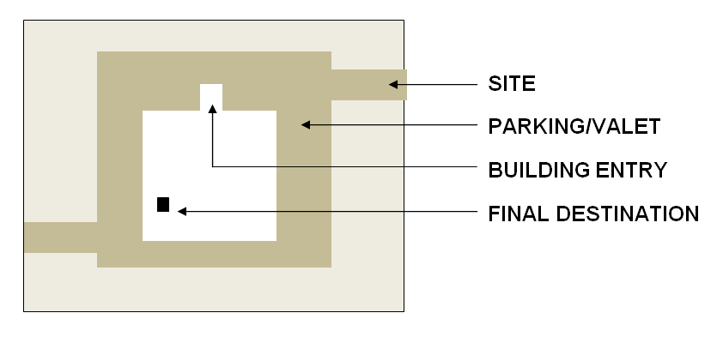
Brain Teaser!
Notes:
I’m going to take you through a common scenario…and then ask you a series of questions. Think about your responses before we do the written portion of this activity.
Think about the last time you went to a place of business or a place of commerce or a transportation area— a place that is bustling with activity.
Visualize the place. Now, let’s imagine you have exited the freeway and are driving to this place from a major street and you are looking for something that will help direct you towards the entrance of the property.
As you are trying to enter the site, what are you looking for? What is the first thing you are going to seek out to get to where you need to go? You want to treat this as if this is the very first time you have been to this location. Write the signs that came down next to the word SITE in your PG.
Now, let’s say you found your way and you have entered the site. What will you do next? Are you going to Park? Or Valet? Write down in PG next to PARKING/VALET.
Once you are parked or out of your car, then what? You need to get inside of the building--How will you get to where you need to go? BUILDING ENTRY
You found your way into the lobby, or the doors of the building. What will you do next? FINAL DESTINATION
Have a volunteer share their example

Slide 5
Planning an Effective Wayfinding System
Create identity
Provide orientation cues
Create well-structured paths
Create regions
Limit choices
Provide a map
Provide signs at decision points
Notes:
Wayfinding is a part of everyone’s life and is something that most people do EVERY DAY.
It is instrumental in finding a desired destination—especially when the place you are in is large, busy, and bustling with activity.
That can be FRUSTRATING!! Especially if you are in a hurry—for example, if you are running into the mall on your lunch hour….how frustrating is that?
Or, in an emergency situation—your child has broken his arm and is in severe pain—your one and only goal is to drive straight to the ER…you do not have time to waste driving in circles or running through the hospital trying to find the emergency room.
Wayfinding becomes critically important on many occasions.
For a builder, a contractor or an architect, wayfinding is the final piece of the puzzle in getting a property, site or campus ready for visitors.
I am going to refer to a hospital project that Ann Marie Hall completed in Lancaster, Pennsylvania. This will be the primary example for the session because it will allow you to see how the Wayfinding steps and considerations are applied successfully in an actual revenue-generating project.
Before we get into too much detail about her project…There are a few basic principles you should know about in regards to planning an effective wayfinding system.
Planning an effective wayfinding system:
Create identity
Provide orientation cues
Create well-structured paths
Create regions
Limit choices
Provide a map
Provide signs at decision points

Slide 6
Decision Points
Will a wrong decision be made if the directional sign is not placed here?
What destinations or information should be included to ensure a good decision is made?
Notes:
Ask two questions when deciding if a “decision point” sign should be placed: Write these down at the bottom of page xxx in your participant’s guide
Will a wrong decision be made if the directional sign is not place here?
What destinations or information should be included to ensure a good decision is made?
When I spoke to Ann Marie about her wayfinding project—remember—the series of hospitals her team is responsible for doing—she told me that during the site surveys, she walked from the entrance slowly with the head of the signage committee from the hospital and methodically thought out where signs should be placed in terms of wayfinding a customer to the building.
She stopped at key decision points—such as the area to turn left or right. Will left take me to doctor’s offices or to the ER? If I turn right, will I end up in the parking garage?
I’ve been mentioning a variety of places where wayfinding is almost absolutely necessary. Let’s recap some of these places and see if we can add some additional ones—where would an effective, well-thought out wayfinding system prove to be necessary?
Allow the class to call out some examples and write these down on the flipchart: Some examples to include are: churches, museums, medical complexes, amusement parks, convention centers, airports, train stations, large hotels, college campuses, libraries, etc.
The next time you are at the airport, going to a museum or visiting a friend at the hospital, move yourself through a mental path…familiarize yourself with what signs belong where, what questions you will ask yourself to get from point A to point B.

Slide 7
Pictograms
Every wayfinding system will include specifications of the Universal Language
Notes:
I’d like to discuss some of the most common signage that will typically be included in a wayfinding system.
But before I do, I want to talk briefly about the universal sign language. Especially in large facilities where a wider audience might be in attendance, using pictograms and symbols help to overcome language barriers and make the signage system usable by even more people.
Why? Because symbols and pictograms speak ALL languages.
Has anyone been to another country and had to rely on the pictograms?
Standard pictograms already in existence
(Pictogram Quiz Handout)/ (Review Answers)/ (Debrief)
Some additional pictograms are on page xx of your PG/ available at www.aiga.com
There are 5 primary areas for signage that you will need to think through when developing such a system.
Can I get a volunteer to read the 5 primary areas / (Review each area. Have them write down some examples).

Slide 8
Typical Wayfinding Signage
Highway Signs
Site Identification Signs
Parking Area Signs
Exterior Building
Interior Building
Notes:
There are 5 primary areas for signage that you will need to think through when developing such a system.
Can I get a volunteer to read the 5 primary areas / (Review each area. Have them write down some examples).
Highway signs are typically a symbolic pictogram that are universal in nature—just like the ones we discussed in our little quiz—but often, if the architect or builder gets permission from the highway code office, you might even be able to have sign with more information on it such as: The University of Texas, Exit 1A.
The next sign you will see after you have left the main road or freeway, is some sort of a sign that will identify the property or site you are trying to find. This site identification sign, most commonly, is a monument sign.
So, the third area—parking area signs—will consist of a mix of communications to let you know where to go—for example they will direct you to Parking Lot A, B or C. They will let you know where the ramp is to the parking garage.
Once parked or out of your car, the exterior building signs will help lead you to the front door. Exterior signs need to be seen from a distance. Identification needs to be made at entries. There needs to be special exterior signs for deliveries, staff only, wheelchair accessible, etc. on all entrance locations.
Now, once you are inside the building, you have whole new source of signage options to look for to help you get to your destination.

Slide 9
Case Study: DFW International Airport
Notes:
Now that we’ve gone through sign possibilities, let’s play a little game. We will have two teams and race to the finish! I have a stack of various pictures of wayfinding signs. The object of the game is put the signs in the correct order before the other team. You’ll place each picture on the floor in a straight line from start to destination.
Here is the scenario: : I’m on my way to an airport I’ve never been to before and I’m depending on the signs to guide my way. I’m looking for DFW airport starting out on the road. I’m trying to find Terminal D to take an American Airlines flight and I need to find the ticket counter.
Debrief/ Ok, now we know what type of signs we might use in a project like this, but what makes the planning process even more critical, is the compliance issue that comes with the placement of these signs.
OK, now we know what types of signs we might use in a project like this, but what makes the planning process even more critical, is the compliance issue that comes from the placement of these signs.

Slide 10
Wayfinding and Accessibility
U.S.A.
Canada
Americans with Disabilities Act (1/26/92)
No federal “Canadians with Disabilities Act” currently
Notes:
Going back to Ann Marie’s Lancaster Hospital example…although her team is responsible for the entire wayfinding signage system at each property, the first site survey they usually complete at each site and the first signs they construct and hang are the ADA signs throughout the interior of the facility.
Why? Because ADA signs are a must in most any wayfinding project and are critical in order for the property to pass inspection.
By handling the “absolutely must have” signs first….
From a construction standpoint, wayfinding systems, in order to be effective, must be as user-friendly as possible for everyone whether in a wheelchair, hearing impaired or visually impaired.
Let’s talk about some of the accessibility concerns when planning a wayfinding system….

Slide 11
Design Elements
Notes:
The signage should be easy to read, recognizable to all, consistent in appearance, compliant by the laws of the ADA and adaptable to change.
As an example: when Ann Marie first began her site surveys with each hospital, she knew immediately that she must establish a standard with her client when it comes to wayfinding and directional signs.
She ran into the problem that many facilities with large staffs face. Every department is going to think they should have their name on the signs. In a hospital situation this could make for simply too many signs—there will be too much wording, too much confusion and it simply would not look aesthetically appealing.
…it was determined that they would only wayfind patients and visitors to locations that are specific to their needs. In other words, they did not put items like plant engineering on a sign since this is not where a patient or visitor needs to go. If a vendor needs to get to plant engineering, it is up to the staff in that office to get the vendor there without signage.

Slide 12
Design Elements
Notes:
Although many familiar rules of design can improve accessibility, signs really have a unique life of their own.
For starters, you will want to choose a unified typeface style…and use it consistently throughout the facility.
Next, use a unified color palette for various sections of the facility—don’t underestimate the power of color as a wayfinding tool! Color-coding wings or floors can be very effective. Strive to use colors that work well together and use other common elements to tie the signs together.
You will also want to use a consistent placement of sign elements. Text, Braille, symbols, and other elements of a sign should be found in the same place on ever sign. The alignment of text—left, right or center, should also be the same on every sign.

Slide 13
Wayfinding Bidding Process
A hard bid
A negotiated bid
A competitive bid
A closed bid
Notes:
Now that you know the scope of what a wayfinding project might entail, let’s talk about how the bidding process works—coupled with the site survey and package recommendations you might be able to offer.
It is important to note that as you grow your center, there will be opportunities for you—as well as for other sign fabricators—to bid for such jobs. Your successful effort will begin when you create a plan that lays out the type and size of wayfinding jobs that you will bid.
You are the best judge of your center’s capabilities, talents and resources.
The scope of work is what you will receive from the owner of the project or contractor. It could be 20 pages or 500 pages long. (Scope handout) But let’s talk about what happens before this: The bid.
(Volunteers read 4 types of bids) Since we know Ann Marie knew her customer and had no competition, what type of bid was hers? (negotiated)
The decision to bid or not to bid is sometimes one of the hardest decisions an owner will face…
if an uneducated decision is made and the project is wrong for your business it can have costly ramifications both financially as well as it could damage the future credibility of the company. Although it is hard to do – passing on an opportunity is sometimes the best decision for your business.
So the question becomes – how do you make an informed decision whether to bid a project or not?

Slide 14
Questions to Ask the Customer
Who else?
Time frame?
Blueprints or access to site?
Assistance?
Bidding process?
Insurance requirements?
Permits and process?
Contracts and terms?
Notes:
I want you to think—think all of the possible projects that may come your way to bid on…big or small, wayfinding or not, is there ever a time you can imagine where you might make the decision to turn a project away? (Flipchart answers)
When you first get the invitation to bid, you should know pretty quickly if your center’s capabilities, time, effort and cost will allow you to take the project on by looking at the general scope of the project.
(Questions to ask the customer activity) Debrief: Can I get a few volunteers to read what they came up with?

Slide 15
Ask Yourself:
Customer’s reputation?
Direct competitors bidding?
Realistic timeframe?
Staff requirements?
Existing customers and their needs?
In-house versus subcontract division?
Sourcing for subcontract?
Installation?
Deposit to cover set up costs?
Payment terms?
Notes:
Now that we have a good list of questions to ask the customer, let’s think about questions you need to ask yourself.
(Questions to ask yourself activity) Debrief: Can I get a few volunteers to read what they came up with?
In Ann Marie’s case, the Lancaster Hospital was already a previous client of Ann Marie’s. She already knew the staff and had good rapport as well as a good two-way communication process, so getting her questions answered was easy.
Once you have all your questions answered and you’ve decided to move forward, you’re ready for the next step.
What do you think the next step is? What needs to be done first so you can see exactly what you are up against? (THE SITE SURVEY)

Slide 16
The Site Survey
Notes:
Prior to performing a site survey, you need to find out about blueprints. Will they be provided and is there a cost associated with them?
ASK! Never be afraid to ask questions before getting into the bidding process. You could easily spend a week of your time bidding a project based on a time-consuming site survey, maybe even longer, and you don’t want to waste your time if this is beyond your current capabilities.
The blueprints or scope of work might say one thing, but when you get on site for an in-depth survey, you might find something totally different.
Ann Marie and her team do several surveys for each site. She feels it can be overwhelming to do the entire survey in one shot—so she does her first survey for the ADA signage, a second survey for all interior directional and wayfinding signage and a third survey for all exterior signage.
(Ann Marie example) This is referred to as liability mitigation. Meaning, what is your liability?
For example, the blueprints provided by the contractor might show a site sign is needed 10 feet from the curb. But once you do your research, learn about the codes, the resources available, the danger of putting a sign too close to the curb—you might find out that the site sign needs to actually be put 30 feet from the curb.
Now, if no blueprints are available – it is recommended that you interview all responsible parties to determine the expectations of the project and ask the contractor if he can supply a floor plan or site map. Every building, site and property should have a planned out map of some sort. Get your hands on this as your starting point.
Also ask if a member of the site staff can be made available to assist with the site survey. Ann Marie walks the grounds of each hospital property with a member of her FASTSIGNS team, as well as a member from the construction committee.
Multiple bids?
Photographs will be your best friend! When taking photographs, you will want to take the picture at any given opportunity—take the picture directly at the sign location—square on—in addition, photograph the surrounding area if necessary, get a close up of where the sign will actually be, note any problem areas on your notepad.
Let’s take a look at some of these site survey photographs. These photographs represent a local hospital similar to the projects that Ann Marie has taken on. I’m going to show you one photo at a time and I want you to tell me what type of sign you think belongs in the space photographed.

Slide 17
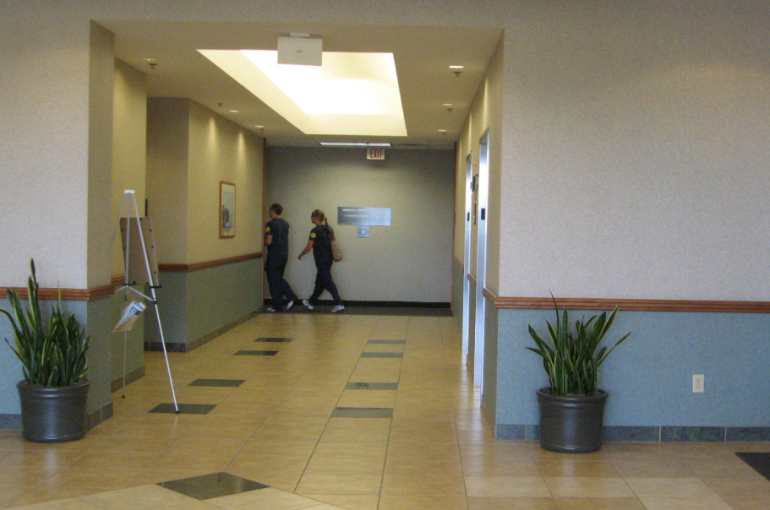
Notes:
In your Participant’s guide, I want you to write down what type of sign you envision belongs in the space.
Ask yourself, if you would have taken this photo while out on a site survey, would you know what sign to design and produce for this area when you return to your center?

Slide 18
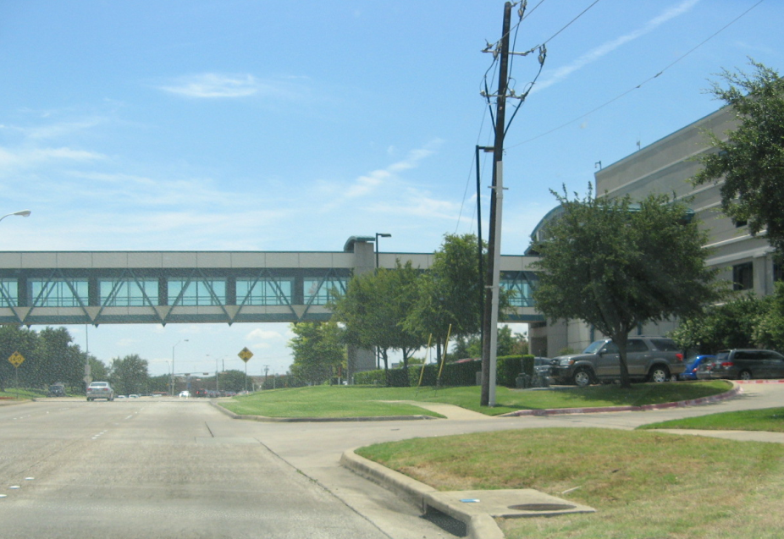

Slide 19
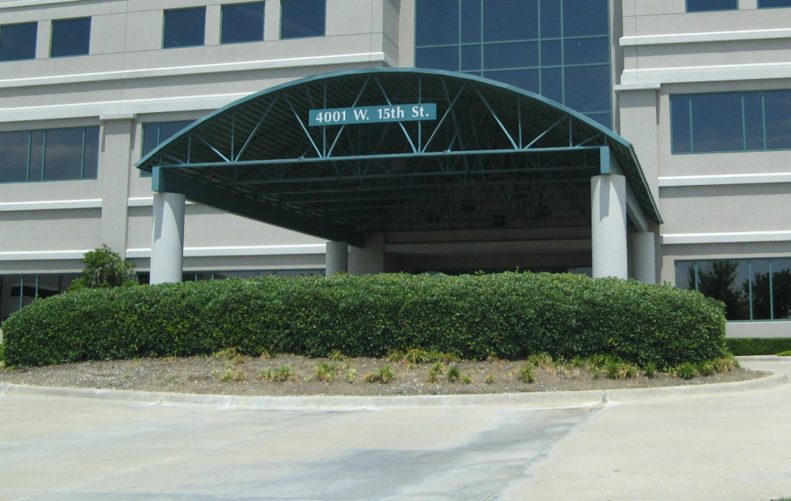

Slide 20
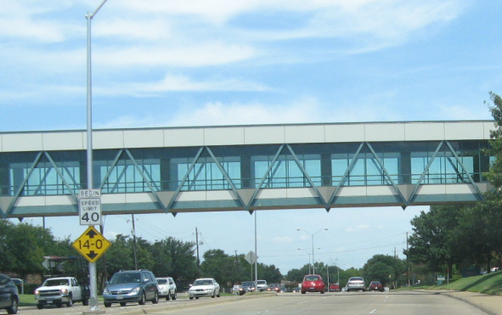

Slide 21
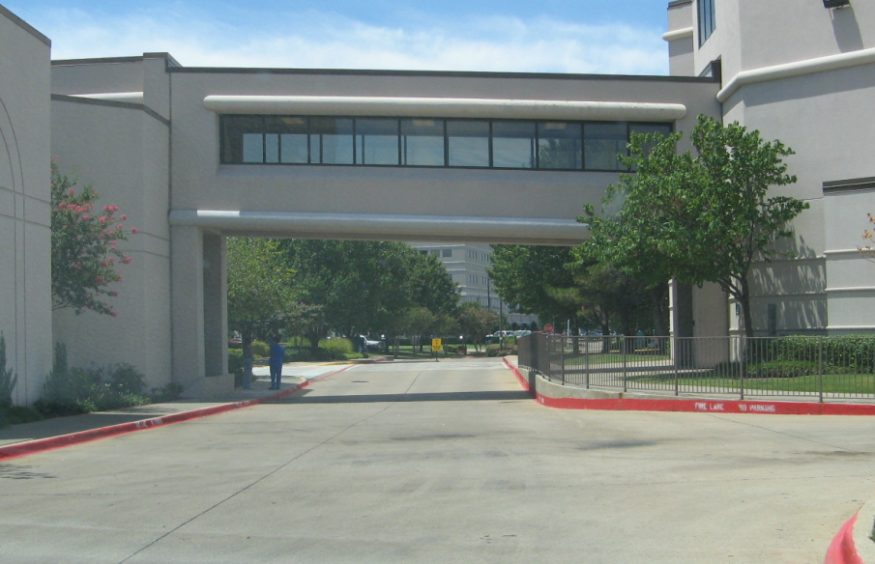
Notes:
Let’s go over them—who want s to volunteer their answers for the class?
Now that we understand the important role that photographs have in a site survey, let’s talk about templates.
Templates will also be your best friend.
Any signs that are up high, on a corner, on a curved wall, on fencing, on a light post, etc…will benefit if a clear, concise template drawing is prepared on-site.
The most difficult dimensions to take accurately, and conversely the most dramatically important, are those of fascia areas—the very front of the sign—or box signs to accept new panels etc.
You will also want to note the location of any obstructions including trees, gates, awnings, etc.
Note any intricate cornice etc. that will effect the sign (take close up photo)
Note the depth of any recessed areas(s) (take close up photos)
Note any other possible problem areas
Note any air conditioning and/or ventilation grills
Let’s take a moment and look at a couple of template drawing examples of a site survey (handout).

Slide 22
Recommending Sign Packages
On letterhead
All details
Breakdowns for transparency
Cost of each sign x quantity
A quote is a contract
Specify the terms for changes
Include payment terms
Notes:
Once the site survey has been completed, you will need to lay everything on the table and determine the products, materials and vendors that will need to go into the actual bid.
Although the bid package might have come to you complete with all of the sign and graphic products specified, your site survey might counteract that if there were code issues, electrical issues, ADA compliance, issues…or just general wayfinding issues that arose from the survey.
Recommendations: yes or no
Are you experienced enough with the product? Do you know the manufacturers warranty and recommendations for use before you spec it out on the bid? It’s one thing to replace a sign due to failure but what it you have to replace 500 signs!
Wayfinding projects can be very time consuming, if you do not cover your costs properly you can lose your shirt!
For a wayfinding project, you are going to want to:
Determine the actual cost and the markup you will need to include in order to make a profit
Estimate the labor for in-shop production
Determine the installation time and number of trips that will need to be made to site

Slide 23
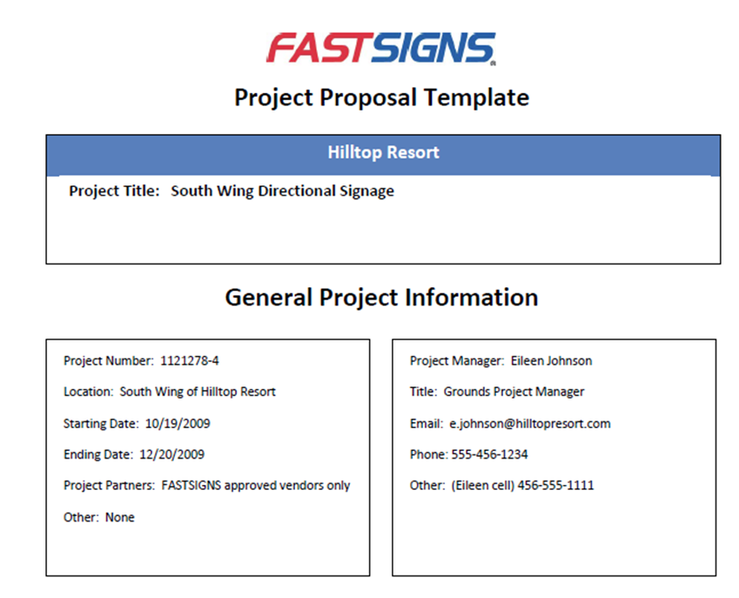
Sign Bid Package
Notes:
The first page of the proposal contains the name of the project along with the contact information and any other relevant information about the project. It will also contain an executive summary of the project and what your plans are to help the client with their needs.
On the next page, you’ll explain why the client would want to choose FASTSIGNS over another vendor and explain how your center will work with the client’s staff. Below that, you’ll want to outline the Project’s Objectives.
On the next page, you’ll offer a brief description of your proposed solution. Notice that the example here describes the various phases of the project. You’ll also want to describe any additional vendors that you will use (if any) and describe their expertise.
Finally, offer the client a timeline of how the project will unfold. When possible, offer up specific dates for beginning and ending of each phase and outline how you will complete the project on or before the client’s deadline.
Lastly, if there are any additional comments that you would like to offer the client, here is where you would do that. Behind the final page of the proposal would be the copy of the estimate from Cyrious.

Slide 24
Site Plan Activities
Exterior Site Plan
Interior Floor Plan
Identification and directionals only
Determine where you anticipate to recommend signage
Braille/ ADA, room identification, directories
Determine where you anticipate to recommend signage
Notes:
(40 minute wayfinding activity)
Here is your task: In a moment, I’m going to break you up into 4 (or 2 depending on class size) teams. I am handing out a site map. Each group will have 10 minutes to sketch where the wayfinding signs should go.
For the exterior signs, you have been requested by a local college to do a site visit and suggest what signs they need for identification as well as directionals. Luckily, you have been provided an overall site plan to study prior to your visit. In order to be as prepared as possible, you want to have an idea of the areas that a sign will be placed so you can take photos of it.
Do not worry about the smaller parking signs (handicapped parking and the like). You need to concentrate only on identification and directions once the end client is on the campus.
(Part 2 of activity): For the interior signs it is a similar situation. There is a new medical building under construction and you have been requested to do a site survey for the interior signage. This could include ADA, room identification, directories and more. Again, you have been provided a floor plan in advance and you want to have a good idea of what signage you feel the client will need and be prepared to take photos of the areas.
Have groups return to seats--

Slide 25
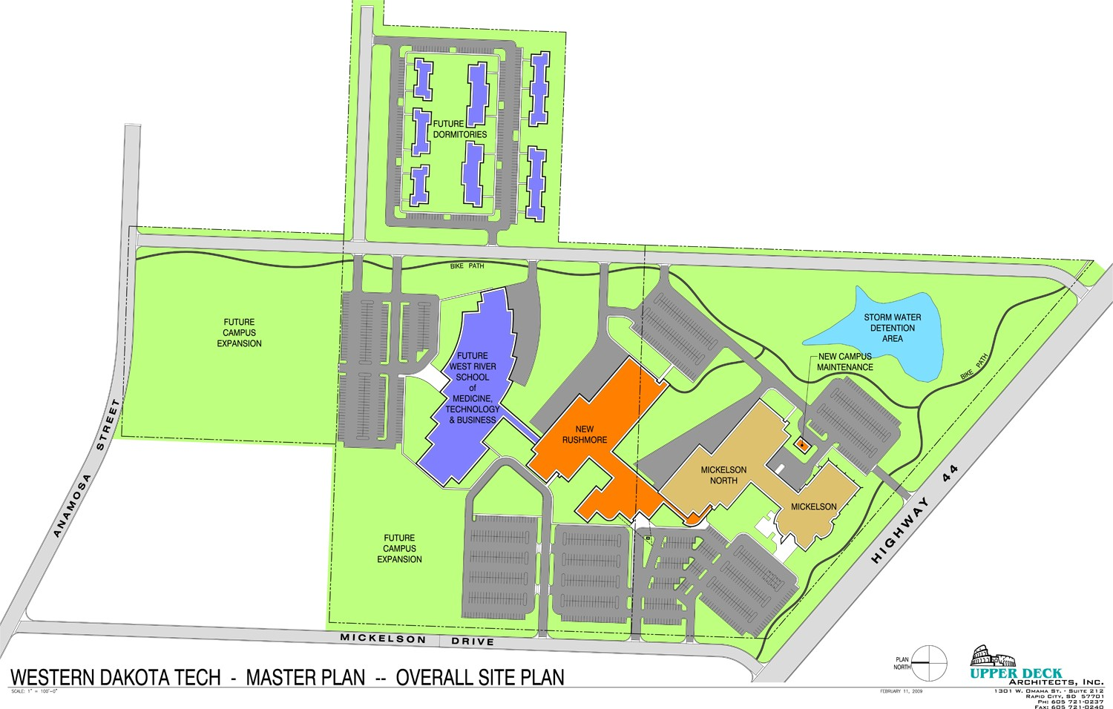
Notes:
We’ll begin with the external signs.
(Mark the signs on the PPT via the Smartboard.)
(Continue this for all 4 groups. Compare to instructor’s copy)
(Repeat for interior signs on next slide—use Smartboard)

Slide 26
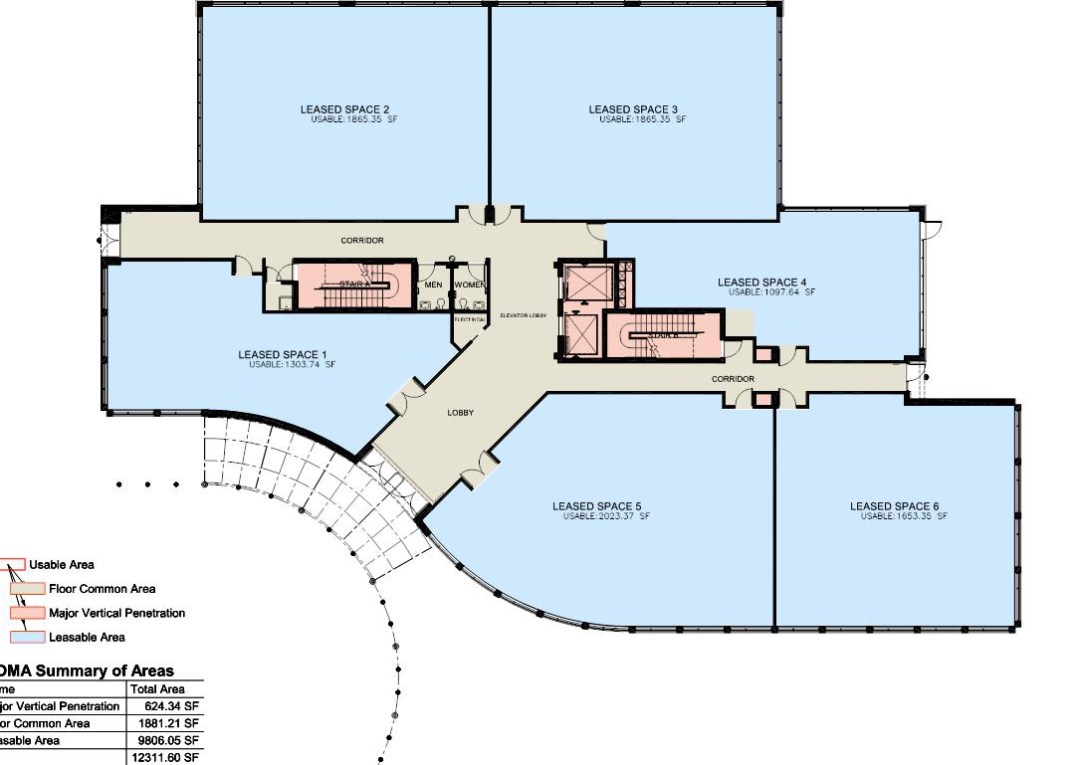
Notes:
(Activity)
So we’ve discussed what is involved with doing a large scale wayfinding project. Some you will want to be involved in and others you won’t. Evaluate and choose wisely!
Successful Wayfinding Questions

Slide 27
Objectives
Identify what wayfinding projects are and how they can become lucrative for a center.
Understand the components of an effective wayfinding solution.
Readily identify pictograms and understand why they are a necessary component of a wayfinding solution.
Interpret a wayfinding system and the decision points.
Understand the process to go through (questions to ask, resources to search for) to determine whether or not to accept this type of a project.
Learn how to deliver wayfinding proposals with product quotes within 100 hours of the completed site survey.
Notes:
Objectives

