Slide 1

THE FASTSIGNS
TRAINING EXPERIENCE
Notes:
Welcome…my role today is to give you an overview of the training and development programs FASTSIGNS offers for new and existing franchise operators. Like everyone else, I will use slides to keep me on track, but don’t hesitate to ask questions at any time.

Slide 2
Drive Performance Improvement
in each of the Four Strategic Objectives through the Development & Delivery of Effective Training Programs.
Notes:
I’m sure you have heard about FASTSIGNS four key strategic objectives a few times during your tour – these objectives are very important for us in training. They keep us focused on what important and what we need to deliver for franchise partners. Our expectation is that training does not take on a task or develop programs unless we clearly understand how it will drive performance in either sales, profitability, brand or satisfaction.

Slide 3
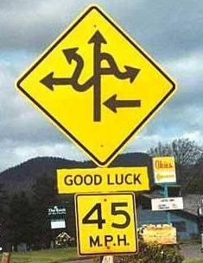
Notes:
Coming on board a new organization can sometimes look like this…(laughter ensues…)
Without solid systems and good guidance, this is certainly the confusion you will face…[next slide]

Slide 4


Notes:
We strive to make your experience a little more predictable…
It may not be easy, and it’s joining a new organization is never perfectly smooth, but you’ll know where you’re headed and you’ll have the training team as your guide.

Slide 5
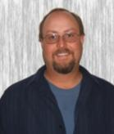
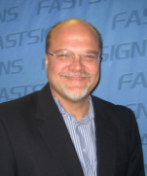
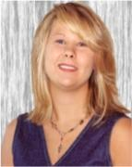
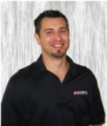
FASTSIGNS Training Team
Jason Myers
Jeff Portwood
Marie Mulligan-McDaniel
Jereme Mentzel
Notes:
Our FASTSIGNS training team is comprised of 4 members, each focused on a specific set of disciplines, but all contributing to new owner training. [next slide]

Slide 6
55
PERFORMANCE IMPROVEMENT
FASTSIGNS
EXPERIENCE
28
PRODUCTION
GRAPHIC DESIGN
Coaching
TRAINING
CUSTOMER SERVICE
TALENT
LEADERSHIP
FRANCHISE CONSULTING
BUSINESS MANAGEMENT
CENTER OPERATIONS
LEARNING
SALES-BUILDING
Notes:
Combined, the team has a total of 28 years of direct-FASTSIGNS experience and about 55 years of management, training and development experience. [next slide]

Slide 7
WIIF
OU
Y
M
Notes:
Have you ever heard of the radio station “WIIFM?”
Well, this is an acronym for all students in a learning environment – it means “What’s In It For Me?” [click]
The training team is always trying to answer the question – “What’s in it for You…”
We are very focused on delivering a training experience that delivers what you need as an individual owner. While we have a standard platform that we operate off of, we work hard to “customize” training to meet the needs of you, your center and market. As part of training, you will interact with market service managers and business consultants that are dedicated to your region. By the time you leave Carrollton you will have built the majority of a business plan specific to your center. [next slide]

Slide 8
Our Approach
Mentoring
Seminars
Webinars
eLearning
BLENDED LEARNING
Instructor-Led
Coaching
Self-paced
Just-in-Time
Experiential
Notes:
We take what is called a “blended learning” approach to training.
This simply means that we use a variety of resources and training techniques to ensure that everyone gets as much as they can out of training. We all learn differently and blended learning helps us make sure new knowledge and skills stick. [next slide]

Slide 9
Deliverables
For New Franchisees
Immersion in the FASTSIGNS business
Maximize learning
Individualize the experience
Accelerate ramp-up
Easy & accessible resources
Notes:
A few of the deliverables that training provides include the following:
IMMERSION in the FASTSIGNS business; while we wish we had all the time in the world to training you at a casual pace, reality is that you are spending money while still in training and pre-opening and it is in all of our interests to get you and your center open as soon as possible – without sacrificing training.
Our FAST101 program is designed to MAXIMIZE YOUR LEARNING in a realistic timeframe. You will get exposure to everything you need to know. You won’t have it all memorized when you leave, but you WILL know exactly where to go or who to call to gain a refresher when a questions arises once you’ve opened your doors.
As I mentioned, we try to INDIVIDUALIZE THE EXPERIENCE as much as possible. We make sure that all franchise partners receive the same training on FASTSIGNS operating systems, yet we work hard to fulfill your needs relative to your center and market.
ACCELERATE RAMP-UP. Another of our objectives, or deliverables, from training is to provide you with the knowledge, tools and resources to help you get up to speed and achieving breakeven as soon as possible. Your sales development consultants will work closely with you to define your breakeven and develop strategies to get there.
Lastly, one of our goals for all franchise partners is to make sure our training resources are easy to find and use. We use the FASTSIGNS Support Site as well as our online learning management system to make all materials easily accessible. [next slide]

Slide 10
On-Boarding
In-Center
Experience
University of FASTSIGNS
FAST101
Continuing Development
Pre-Opening
5
2
14
DAYS
WEEKS
DAYS
Notes:
The on-boarding experience takes place in several phases…You will participate in three week’s of on-site training – one week of In-Center training working with an existing successful franchise partner to observe and shadow what a day- or week-in-the-life of a center looks like.
From there you will come to Carrollton and attend two weeks of FAST101, where we will take you through everything you ever needed to know about FASTSIGNS.
We generally like you to attend FASTSIGNS within about 14 days of opening or turnover of your center, that way your experience is still fresh and retention high.
One phase that is not noted on this slide is what we refer to as “pre-training” – as soon as you sign your franchise agreement, we register you for the University of FASTSIGNS, which is our online learning platform. We have curriculum set up for franchise partners to help you understand some basics about the business, operations, product knowledge, etc. that will better prepare you for hands-on training. [next slide]

Slide 11
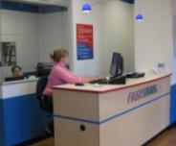
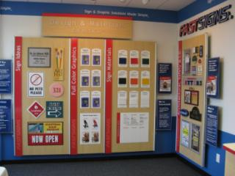
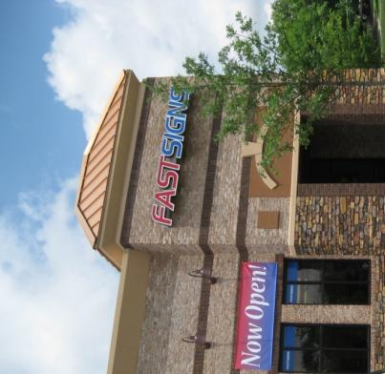
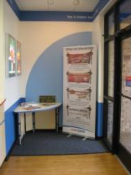
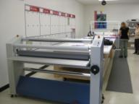
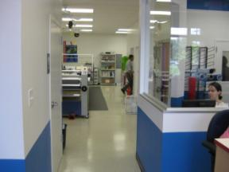
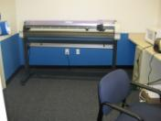
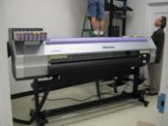
In-Center Experience
Notes:
This is just a quick slide that shows different elements of a center that you will be exposed to during In-Center training.
We provide a loose-agenda that serves as a checklist of activities and topics to observe or engage in, but basically you will follow the daily schedule of the center – if there’s an installation then you’ll go along, if there are sales calls scheduled then you will shadow, if there’s a big project you may lend a hand…however much you want and are able to do. Having In-Center training before FAST101 class enables you to better understand the operation so you have a clear picture in your head as we discuss concepts and systems while in the classroom. [next slide]

Slide 12
FAST101 Program
100 Hours of Hands-on Training
SUBJECT-MATTER EXPERTS
3 Tracks: Franchise Partner, Graphic Designer, Customer Service Rep
36 Modules for Franchisees
All aspects of the FASTSIGNS business
Notes:
What we call FAST101 is the two-weeks of training here in Carrollton.
You will experience about 100 hours of instruction with about 36 modules covering all-things-FASTSIGNS. New centers and conversion centers also send a customer service / salesperson and a graphic designer. New franchise partners buying an existing center – called “resales” – only send the franchise partners who will own the business.
All courses are taught by FASTSIGNS subject matter experts from all departments, including marketing, operations, tech, business intelligence as well as members of the training team. [next slide]

Slide 13
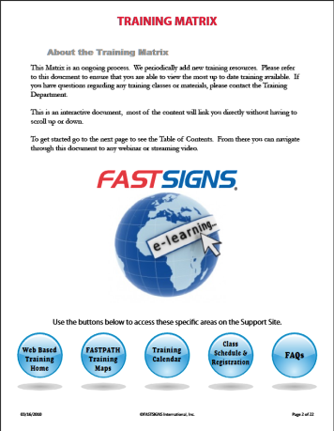
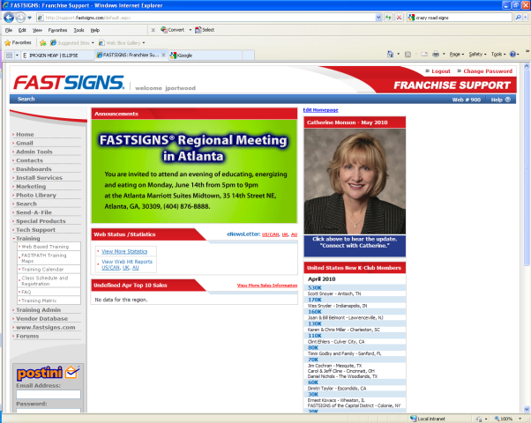
Support Site
Web-based Training
FASTPATH Training Maps
Training Calendar
Class Schedule
Registration
FAQs
Notes:
Earlier I mentioned our Support Site. This is sometimes called an Intranet or portal at some companies; it’s an online warehouse of information for franchise partners.
Training has a dedicated section on the support site where you can access a large amount of our training content, including learning maps for position training, audios and videos and view our training calendar that lists events like webinars, vehicle wraps and other activities.
There is a tremendous amount of content on the Support Site, so we’ve created this “training matrix” which is like a college course catalog…it lists all assets we have on the support site [next slide]

Slide 14
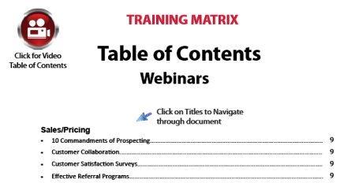
Training Matrix
Provides quick easy access to training resources.
Notes:
The training matrix is an interactive document that you can place on your desktop. When you want to look up a course, you can use the table of contents to click on topic [next slide]

Slide 15
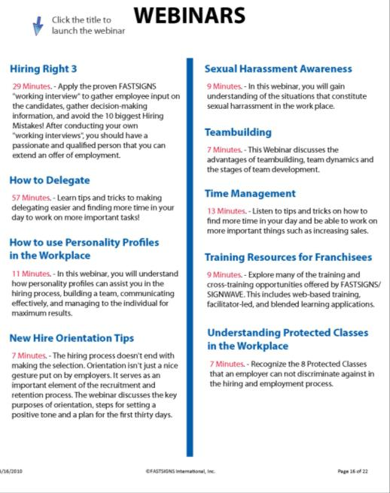
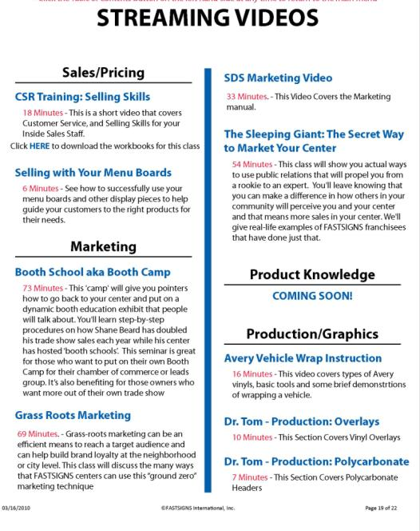
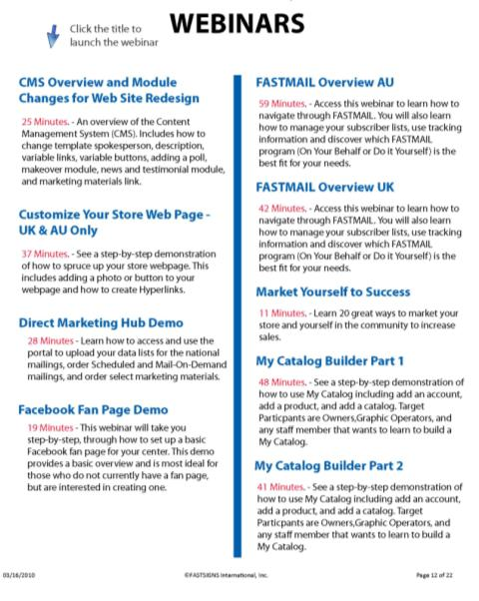
Resources & Support
Notes:
…and the document will take you to that section. There you can read descriptions for each course, video, etc. that’s available and when you click on the title you will be sent straight to that course on the support site.
This makes it very easy to find information and resources. Out Tech department and marketing have similar interactive documents to find info about their areas. [next slide]

Slide 16
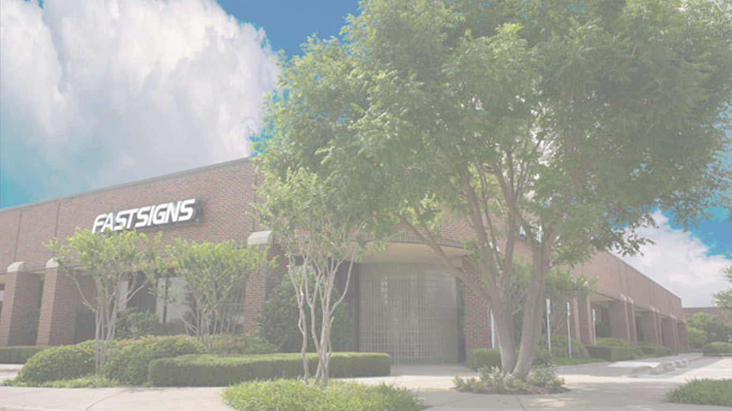
UNIVERSITY OF
FASTSIGNS
Notes:
You’ll hear us talk about the University of FASTSIGNS. This represents the growth and future of training at FASTSIGNS as we have been building out our programs and strengthening support for franchise partners and their teams. [next slide]

Slide 17
University of FASTSIGNS
Online strategy
  Support site
  Learning management system
“WYN-WYN” for franchisees
  What you need
  When you need
Notes:
Our online presence is a large part of our strategy and we will introduce you to the University of FASTSIGNS and online learning as soon as you sign your franchise agreement.
Combined with the Support Site, we have more than 500 assets available online, in a myriad of topics. And we’re continuously building new FASTSIGNS-specific content.
That last bullet is just something goofy I threw in to take up space, “WYN-WYN” get it?

Slide 18
FASTSIGNS Convention
Annual Convention
Seminars & Classes
Networking Opportunities
Motivational Speakers
Extensive Vendor Show
Notes:
Before I forget, and to bring the presentation part to a close, I must mention our Annual Convention.
This is a key event held in January each year that brings together several hundred franchise partners, FASTSIGNS staff and vendors. It’s a great event for networking with your peers, taking classes on a variety of topics and attending the vendor show. The vendor show is a highlight of the convention – more than 100 vendors set up shop for two days and are focused solely on the FASTSIGNS community. Our franchise partners love it because they get individualized attention and don’t have to be “qualified” and our vendors love it because they can focus just on the FASTSIGNS brand and servicing our needs.
This coming January our convention will be held at the Gaylord Opryland Resort outside Nashville, Tennessee. If you’re coming on board by the end pf the year you will definitely want to attend.

Slide 19
THE FASTSIGNS
TRAINING EXPERIENCE
Thank You!
Notes:
That wraps up the slide presentation…I’d like to answer any questions you have about training. What questions do you still have?
Thanks for visiting, it’s a pleasure to meet you and I look forward to working with you soon.

